Slide 1

CSCI-3753: Operating Systems Fall 2020
Biljith Thadichi
Department of Computer Science University of Colorado Boulder
Slides based on presentation by Anh Nguyen

Slide 2
Week 10 > Process Scheduling > PA3 doubts
2

Slide 3
Scheduling Policies
First Come First Serve (FCFS) Scheduling
Average waiting time?
Average turnaround time?
Task | CPU Execution Time (ms)
T1 | 6
T2 | 8
T3 | 7
T4 | 3
3
Notes:
TAT - The interval from the time of submission of a process to the time of completion is the turnaround time.
Waiting time - . Waiting time is the sum of the periods spent waiting in the ready queue.
o get into memory, waiting in the ready queue, executing on the CPU, and doing I/O.

Slide 4
Scheduling Policies
First Come First Serve (FCFS) Scheduling
Average waiting time?
Average turnaround time?
Task | CPU Execution Time (ms)
T1 | 6
T2 | 8
T3 | 7
T4 | 3
T1 | T2 | T3 | T4
0
6
14
21 24
4
Notes:
TAT - The interval from the time of submission of a process to the time of completion is the turnaround time.
Waiting time - . Waiting time is the sum of the periods spent waiting in the ready queue.
o get into memory, waiting in the ready queue, executing on the CPU, and doing I/O.

Slide 5
Scheduling Policies
Shortest Job First (SJF) Scheduling
Average waiting time?
Average turnaround time?
Task | CPU Execution Time (ms)
T1 | 6
T2 | 8
T3 | 7
T4 | 3
5

Slide 6
Scheduling Policies
Shortest Job First (SJF) Scheduling
Average waiting time?
Average turnaround time?
Task | CPU Execution Time (ms)
T1 | 6
T2 | 8
T3 | 7
T4 | 3
T4 | T1 | T3 | T2
0 3
9
16
24
6

Slide 7
Scheduling Policies
Preemptive Shortest Job First (SJF) Scheduling
Average waiting time?
Average turnaround time?
Task | CPU Execution Time (ms) | Arrival Time
T1 | 8 | 0
T2 | 4 | 1
T3 | 9 | 2
T4 | 5 | 3
7

Slide 8
Scheduling Policies
Preemptive Shortest Job First (SJF) Scheduling
Average waiting time?
Average turnaround time?
Task | CPU Execution Time (ms) | Arrival Time
T1 | 8 | 0
T2 | 4 | 1
T3 | 9 | 2
T4 | 5 | 3
T1 | T2 | T4 | T1 | T3
0 1
5
10
17
26
8

Slide 9
Scheduling Policies
Round Robin Scheduling
Let time slice = 4 ms
Average waiting time?
Average turnaround time?
Task | CPU Execution Time (ms)
T1 | 6
T2 | 8
T3 | 7
T4 | 3
9

Slide 10
Scheduling Policies
Round Robin Scheduling
Let time slice = 4 ms
Average waiting time?
Average turnaround time?
Task | CPU Execution Time (ms)
T1 | 6
T2 | 8
T3 | 7
T4 | 3
T1 | T2 | T3 | T4 | T1 | T2 | T3
0 4 8 12
15 17 21
24
10

Slide 11









Multilevel Queue Scheduling
Preemption or voluntary yield
Ready List₀
Ready List₁
Scheduler
CPU
Done
Ready List₂
New Process
All processes at level i run before any process at level j.
At a level, use another policy (e.g., RR)
Ready List_{n}

Slide 12
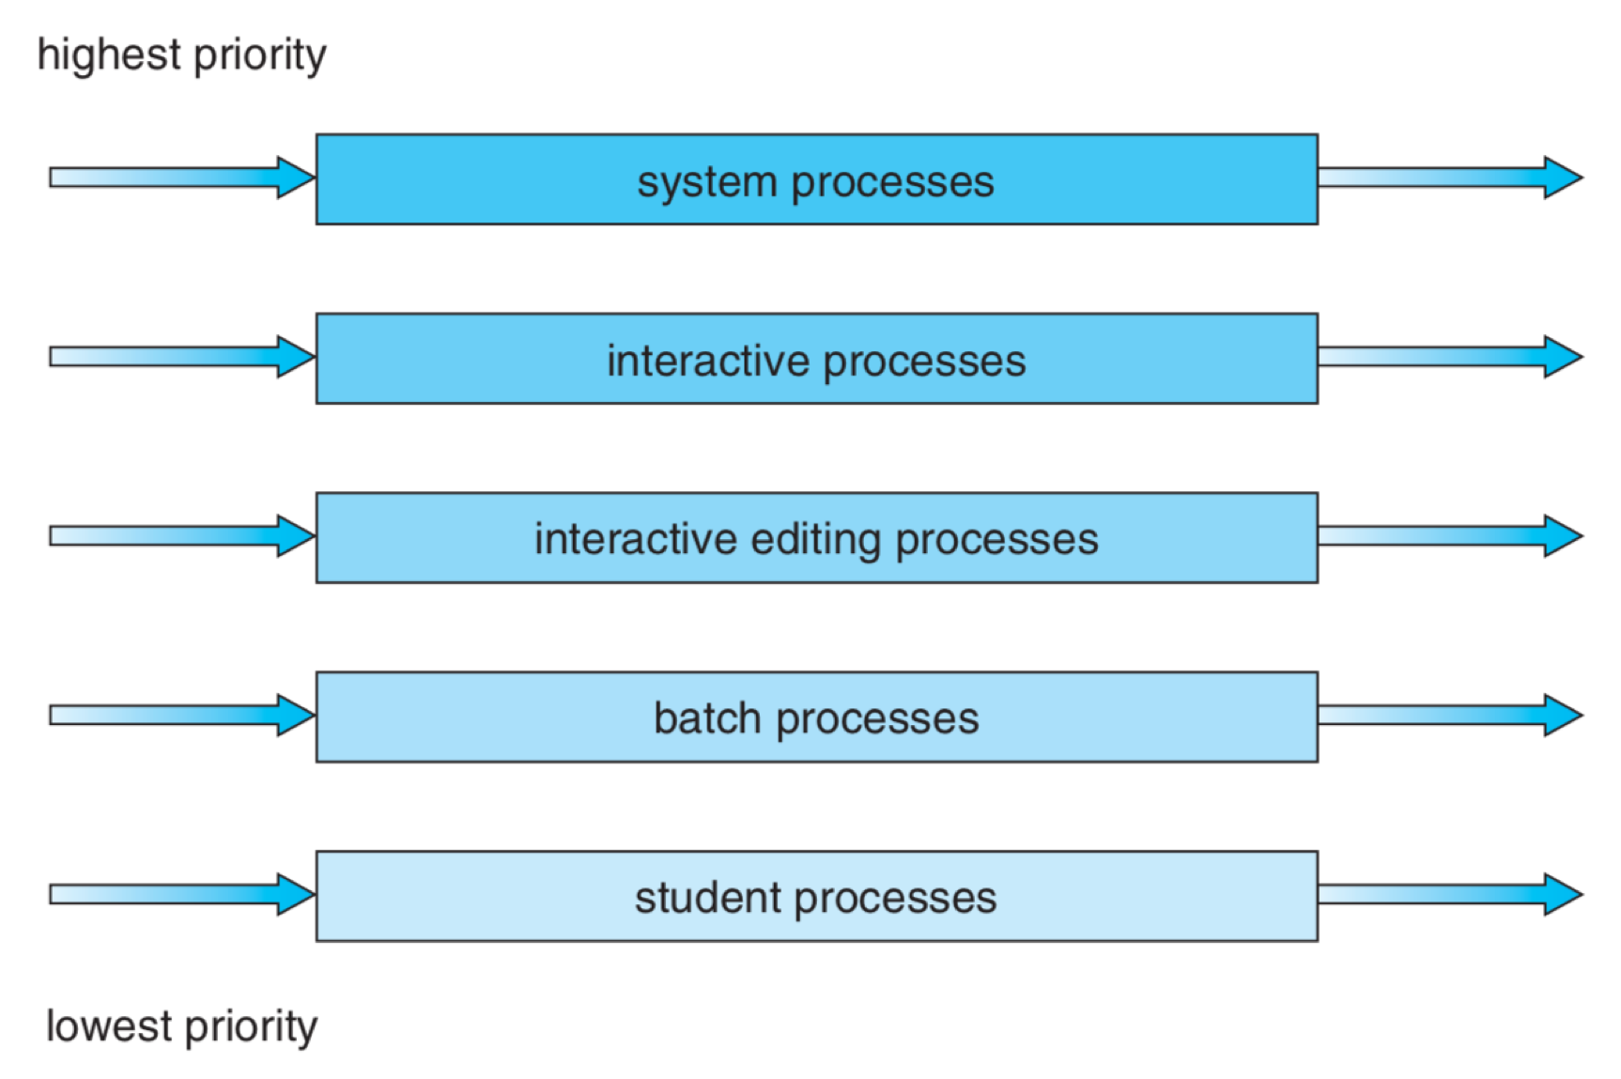
Multilevel Queue Scheduling

Slide 13






Multilevel Feedback Queue Scheduling
Preemption or voluntary yield
Ready List₀
Scheduler
CPU
Done
Ready List₁
New Process
Allows processes to move between queues in either direction
Ready List_{n}

Slide 14
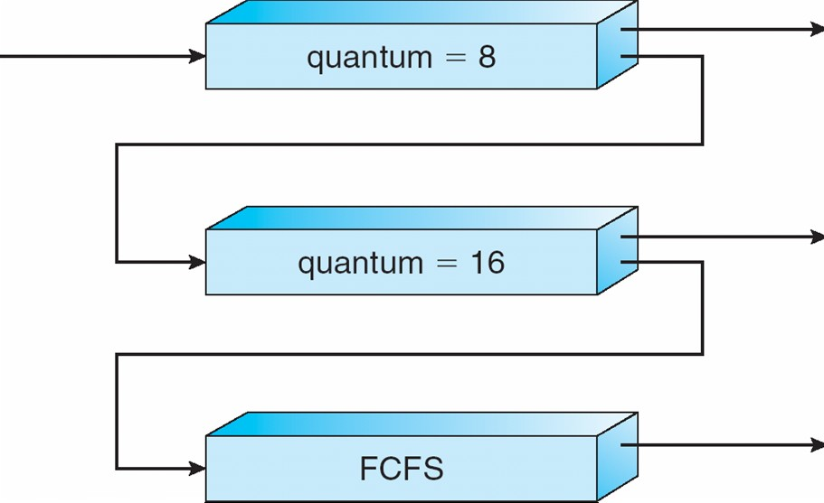
Multilevel Feedback Queue Scheduling
Three queues:
Q₀ – RR with time slice 8 milliseconds
Q₁ – RR with time slice 16 milliseconds
Q₂ – FCFS
Q₀
Q₁
Scheduling
A new job enters queue Q₀ and receives 8 ms.
If it does not finish in 8 ms, the job is preempted and moved to Q₁.
At Q₁, the job receives additional 16 ms.
If it still does not complete, it is preempted and moved to Q₂.
Interactive processes are more likely to finish early, processing only a small amount of data.
Compute-bound processes will exhaust their time slice.
Q₂
Interactive processes will gravitate towards higher priority queues, while
compute bound will move to lower priority queues
Notes:
Why is this a good idea?

Slide 15
Week 10 – Checklist
Schedule Interview Grading
Complete the Quiz
Start on PS3
20

Slide 16
Week 10 > Process Scheduling > PA3 doubts
16

